Slide 1
The Shift from Process-Centered to People-Centered
Wachusett Medical Reserve Corps

Slide 2
Industrial Age
The metaphor of the organization as a machine becomes apparent—an easily programmable structure that will run the “program” we define and then pivot in a new direction as soon as we provide new instructions.
By and large, this was true up until the end of the 20th century. The corporate structure and the needs of the organization were tantamount, and the individuals in the system were seen as “human resources,” in effect a cog in the wheel of the machine, easily replaceable when they wore out.

Slide 3
New Age
The systems we live and work in were designed in the past. They were created to serve the Industrial Age, which valued productivity, efficiency, and return on capital above all. The systems did the job they were supposed to do, but they didn’t anticipate where we were headed: into an age where human creativity is the most valuable resource.
The very basis of competition has shifted in the modern world: from productivity, efficiency, and output to creativity, innovation, and purpose.

Slide 4
Growth of an Organization
Like people, plants, and other living organisms, corporations are born, grow old, and die. They are governed by the same laws of life as other living beings and follow the same hierarchy of need fulfillment as people do. They marry through mergers and give rise to offspring (or spin-offs). When they mature, they have the choice of rebirthing, of branching off in new directions (new markets, new products, or totally new business models), or withering away and dying.
This makes intuitive sense—organizations are groups of humans united to achieve a common goal. In fact, the word “corporation” comes from the Latin corpus, meaning body.

Slide 5
Upgrading
We should upgrade it to meet the needs of the modern organization.
That requires looking at the challenge from a human-centered perspective and reconsidering the organization as a vibrant organism.

Slide 6

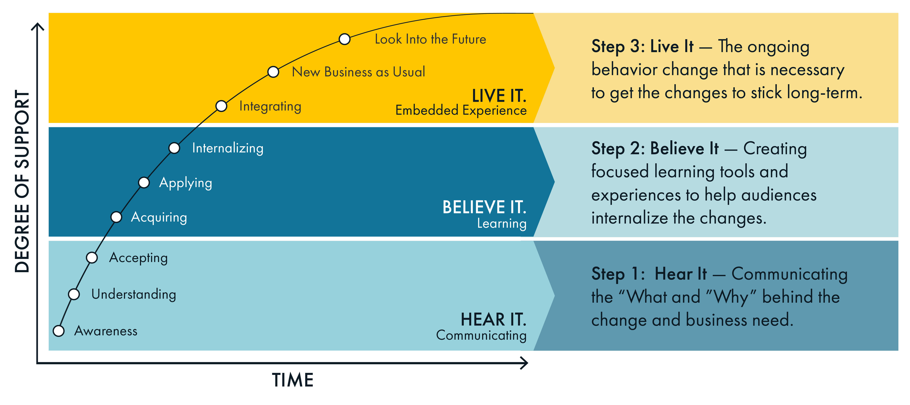


Slide 7
Shifts
If we begin thinking of organizations as organisms, some clear implications emerge, and required shifts become apparent:
  From program to persuade: We can’t just push a new program or strategy—we need to generate excitement and create pull around a shared vision.
  From command to engage:. We can no longer drive adoption or force buy-in; we need to authentically engage volunteers to participate in the change.
  From cascade to co-create: We need to honor the intelligence among our teams by inviting them to co-create better solutions.
  From processes to principles: Every organism is unique and dynamic, and we need to adopt methods to context by creating guardrails instead of rules.
  From homogeny to diversity: People, like cells in our analogy, are each living beings nested within the whole. Both individual people and teams have their own wants and needs. We need to consider the whole spectrum of stakeholders and address them individually. No more “one size fits all” change programs!

Slide 8
Summary
To accomplish change, we can’t just reprogram the machine. We need to persuade and engage empowered, thoughtful humans to move in a new direction, at scale. Therefore, we need to rethink how we organize, manage, and lead them.

Slide 9
Believe It
Step 2- Learning

Slide 10
Change Initiative
Making change happen is a monumental task. How do you move people from passively hearing about a change initiative to actually believing in it—and even championing it with gusto?
Assuming people will snap to a new plan once they hear it is one reason 80% of strategies fail—no matter how well conceived the plan.
People need help making sense of the plan, connecting to it, and navigating points of ambiguity before they can jump on board.

Slide 11
Outline
Day 1: Fundamentals of Strategy Activation & Envision, and Getting Started with Strategy Activation.
Create a clear and authentic vision that will speak to the hearts and minds of the people responsible and show them the path to realize it
Ensure strategic goals are met by establishing a measurement system
Begin the Discover phase by identifying key stakeholder groups
Understand the perspectives, needs, and openness to change for all key stakeholders

Slide 12
Next
Day 2: Discover & Design
Understand what’s challenging about the culture today, and how it might need to shift in the future
Get a picture for how the organization perceives change, and where resistance might occur and why
Understand the external forces working for or against your organization in order to prepare for or take advantage of
Draw insights emerging from the Envision and Discover phases in preparation for designing the plan

Slide 13
Making It Happen
Day 3: Execute
Chart the course ahead and prepare for known and unknown needs
Explore the twelve core categories of building blocks in an activation plan
Bring all the components together into an actionable Strategy Activation plan
Harness the power of group learning through sharing and providing feedback on draft activation plans

Slide 14
Resources
XPLANE 811 SW 6th Ave, Ste 850 Portland, OR 97204 https://xplane.com/

