Slide 1

PET First Aid
Emergency Care

Slide 2
Introduction
Definition- Pet First Aid is the immediate care given to an injured or suddenly ill pet as temporary assistance until competent veterinary care is available.
Properly applied first aid can save your pet’s life, reduce recovery time and be the difference between temporary disability and lifelong disability.

Slide 3
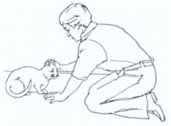
Approaching an Injured or Ill Animal
Always approach with caution, they may not understand that you are trying to help.
Remain calm and use a reassuring voice.
Watch for warning signs like growling or their ears are pinned back.
Responders are more likely to be bitten by animal that is afraid.

Slide 4
Before you help…
Remember that like humans, animals have a collection of bacteria they live with as well. Some are harmless and others can cause disease.
Consider all body fluid contagious, and use gloves or some other barrier if handling blood, urine or feces.
Notes:
Universal Precautions….Bloodborne Pathogesn

Slide 5
Before you help…
Check your environment for hazards that may potentially hurt you.
  Watch for traffic.
  Watch for down wires.
  Watch for rushing water.

Slide 6
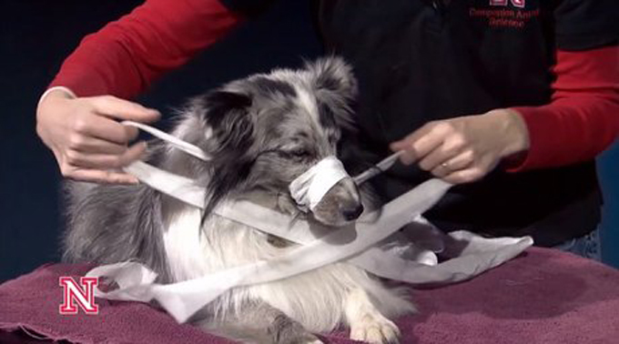
Restraints
If the pet is a dog or an animal with a long snout it may require a muzzle to prevent injury to yourself or to others providing assistance.
Using a muzzle in this type of situation is not considered cruel and will not hurt the animal if done correctly.
Approach the dog in a calm, soothing manner.
Lay the dog down in a comfortable position.
Get a long piece of gauze.
Make a large loop at the center of the gauze.
Bring the ends of the gauze back under your dog’s muzzle.
Bring the gauze behind the ears.
Be sure to have a pair of scissors handy.
Notes:
Blanket hold/ Velcro to protect against claws/ Elizabethan Collar

Slide 7

Assess- Alert- Attend
Assess responsiveness If unresponsive,
  Notify authorities or an animal health care professional
  A bystander can call a veterinarian immediately – make sure to delegate!
ATTEND to the
  A - Airway - Gently tilt animal’s head backward to open the airway and inspect for materials or fluids
  B - Breathing -LOOK for chest to rise and fall and LISTEN for breathing. FEEL for breath on your cheek.
    If breathing is absent, give two rescue breaths
    If pet is breathing, maintain body temp. and arrange transport
  C – Circulation - If pet does not start breathing or moving, or the heartbeat is ABSENT, start CPR
    If breathing, moving or heartbeat is PRESENT, check for and control major bleeding
Notes:
Finding the heart beat…
CPR for animals..

Slide 8
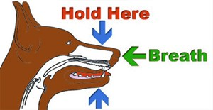
Rescue Breathing
Done if there is no breathing but there is a heartbeat.
Seal the upper and lower jowels with your hand to prevent air from escaping.
Give two breaths 2-3 seconds each through the nose.
Each breath should have enough force to make the chest rise but not any more.

Slide 9
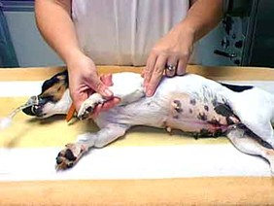
Checking for a Pulse
Practice finding your pet’s heart beat!!
On pet’s chest wall just behind the point of the elbow
Inner thigh where the leg meets the body
Below the ankle on the side of the front of back paw
CPR - Cardiopulmonary Resuscitation *If a pet is unresponsive and there are no signals of circulation (breathing or pulse)…START CPR!
Notes:
30-2 CPR…

Slide 10
Recovery Position
A suitable position for a stable but unconscious pet Lay the pet on its side with head and neck slightly extended. Fold a blanket or towel and place it under the shoulder (not the neck) so that the chest is above the head. This is to prevent fluids from the mouth from going into the lungs. Keep the pet warm by covering it with blankets. Transport the pet as soon as possible to a veterinarian.

Slide 11
Bleeding Control Steps
Restrain animal first. Use a sterile or clean dressing, apply gentle pressure over wound Wrap roller gauze around wound site. Tie knot directly over wound
Caution: Do not tie TOO tight or you may cut of circulation.
If bleeding does not stop, use the flat part of your fingertips to compress the nearest artery (pressure point).

Slide 12
Shock
Signs of Shock
  Restlessness, anxiety, weakness, trembling
  change in level of responsiveness
  tongue, gums or inner eyelids may appear gray, blue, or whitish
  rapid, shallow breathing
  rapid weak pulse
  extreme thirst
  cold face/ extremities
  temperature below 100 o F
Shock is uncontrolled internal or external bleeding.

Slide 13
Care for Shock
  Perform initial assessment: Assess – Alert – Attend
  Open and maintain airway / Perform rescue breathing and CPR, if necessary
  Control bleeding, if any.
  Maintain as near normal a body temperature as possible.
  Try to sooth and relax pet, and keep it as quiet as possible.
  Make arrangement for immediate and safe transport of pet to a veterinary hospital.

Slide 14
Assessing for Injuries
Inspect (look) and palpate (feel) for signs of injuries-
  Deformities
  Open injuries
  Tenderness
  Swelling

Slide 15
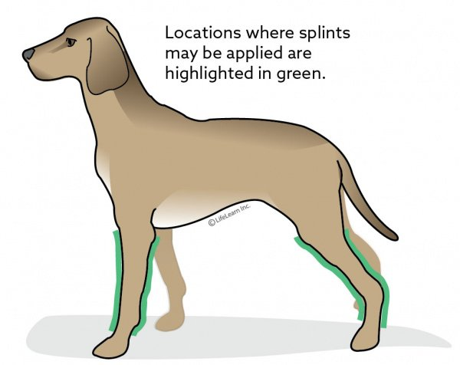
Limb Injuries
Limping
Deformity
Pain and Tenderness
Swelling
Exposed bone ends
Pet cannot support weight
Loss of limb function.
Bandages can be readily applied to the head, neck, chest, tail, or lower legs of a dog. Splints are usually applied below the knee on the back leg or below the midpoint of the humerus (the bone that connects the shoulder to the elbow) on the front leg.

Slide 16
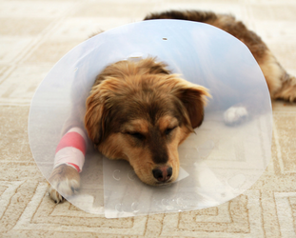
Wound Care
Protective bandages that are applied to pets will always be made up of several layers of bandage material, and whenever possible they will wrap entirely around the body part that is being protected because the do not stay like a bandage to human skin.

Slide 17
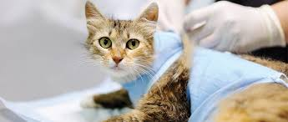
Dressings in Layers
First layer of bandage material will be a dressing layer
The purpose of the nText layer of bandaging material is to help keep the dressing in place, and to provide some padding to the area to be protected. It will either be rolled gauze material, cotton, or synthetic cast padding.
The third layer of material is usually made of a stretchy material that sticks to itself without adhesive.
Notes:
The purpose of this tougher layer of material is to provide further protection to the underlyiIf the purpose of the bandage is to protect a surgical incision t or a non-infected wound, the dressing layer will be made of a material that will not stick to the wound.
If the wound is infected, the dressing layer will be made of a sterile material that will stick to the wound and help draw out the infection, or will contain a medication or other agent that will assist in controlling the infection.

Slide 18
Burns
1 st Degree Burns | Red or swollen skin which is painful to touch. | Immerse or flush the area with cool water 15-30 minutes.
2 nd Degree Burns | May see blisters. Skin may be red,swollen and moist. Area is painful to touch. | Cover area with dry sterile non-stick dressing. Make arrangements for immediate and safe transport to veterinary clinic.
3 rd Degree Burns | Blisters. Open areas and oozing Area painful | Cover area with dry sterile non-stick dressing. Make arrangements for immediate and safe transport to veterinary clinic.

Slide 19
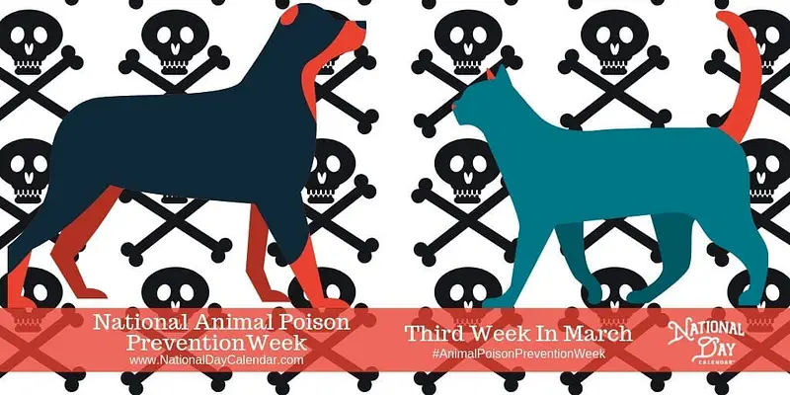
Poisoning
Despite the safeguards we take, our pets are curious and, sadly, thousands of pets are impacted by ingesting something poisonous every year.
Fortunately, pet poison control hotlines are available and are ready to help. This is a service that is offered by a number of microchip companies, and the American Society for the Prevention of Cruelty to Animals (ASPCA) also has a poison control hotline, which can be reached at (888) 426-4435.

