Slide 2
Welcome! The following slides are to
Provide an introduction to the Medical Reserve Corps (MRC)
Provide an introduction to the role and benefit of an MRC for the local community.
Provide a pictorial of the activities that volunteers of the MRC have participated in.

Slide 3
MRC Concept
To establish groups of volunteers with an interest in strengthening local public health system and providing help in emergencies.
Organize/utilize locally
Integrate with existing programs and resources
Identify, credential, train and prepare in advance
Include medical and public health professionals, and others

Slide 4
Grab and Go Backpacks
Home and Personal
If there were a fire and you had to grab and go…..

Slide 5
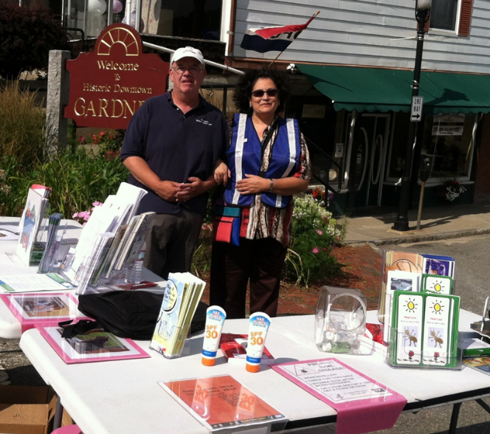
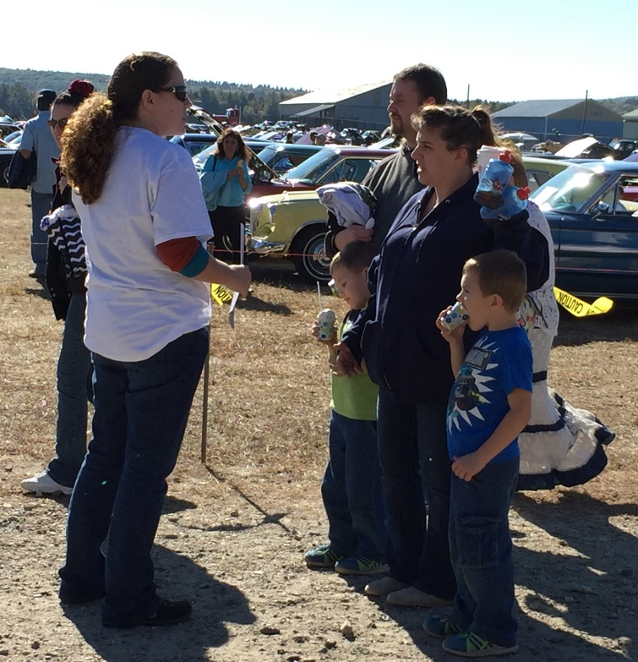
Family and Pet Preparedness
Gardner, Ma
Orange, Ma

Slide 6
Mission of the Medical Reserve Corps
National: The mission of the Medical Reserve Corps is to improve the health and safety of communities across the country by organizing public health, medical and other volunteers.
Local: Wachusett Medical Reserve Corps (WMRC) is a local network of public health, medical, safety and other ancillary volunteers organized to improve the health and safety of their communities. (2020)

Slide 7
MRC Vision
National: A nationwide network of organized volunteers strengthening the health and safety of their communities.
Local: Our communities, with the help of skilled volunteers, will be well informed, prepared, healthy and safe. (2020)

Slide 8
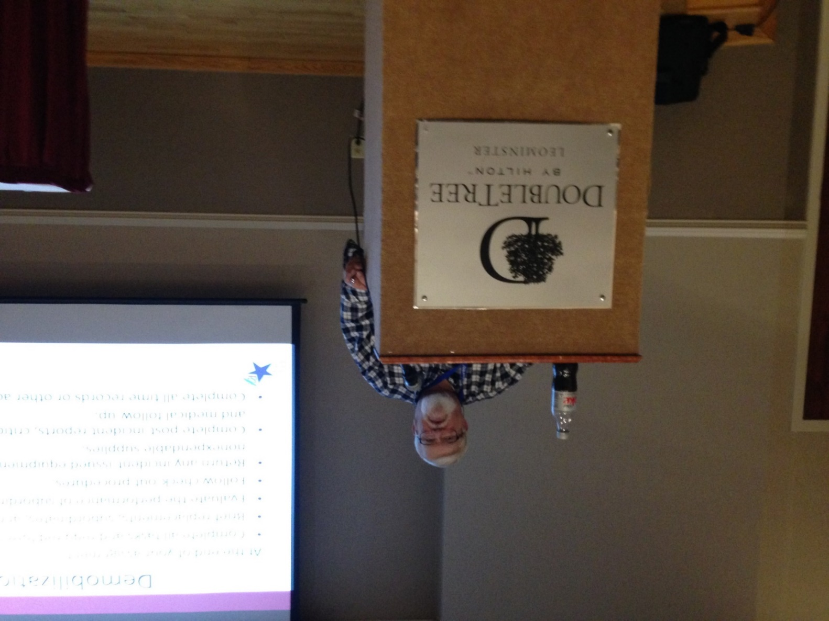
Incident Command System Training
Barry teaches about using the command structure during a public health emergency

Slide 9
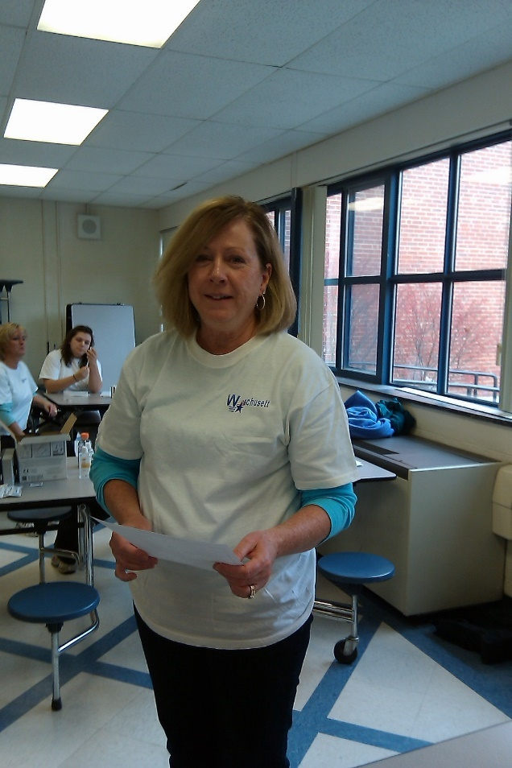
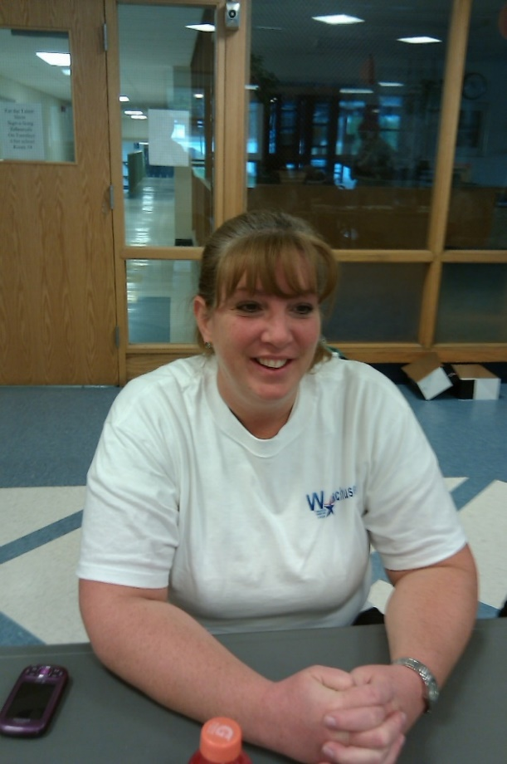
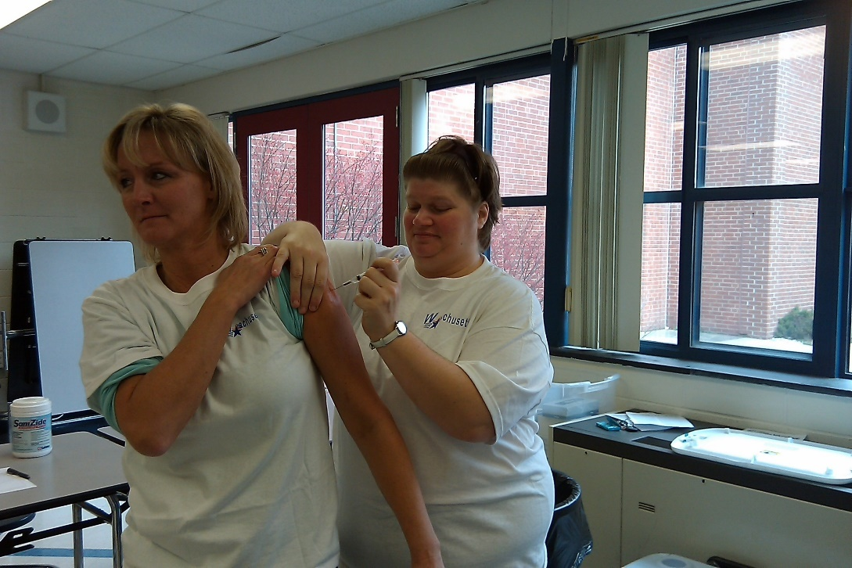
Vaccine Clinics

Slide 10
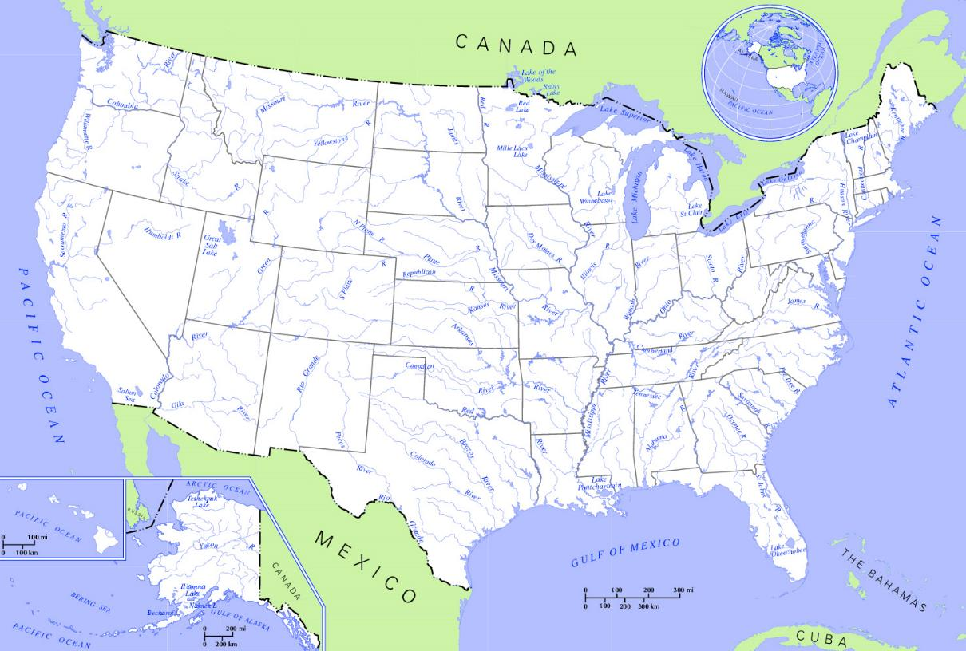
Status - Current Local Units
Approximately 815 Units,
About 300,00 Volunteers across the nation
Notes:
This is a screen capture of map the shows locations of current MRC units.
Unit data is as of April 11, 2007.
This map is updated every time a new unit is added to the MRC website – please visit the MRC website URL link listed in the slide for the most current and up-to-date unit information.

Slide 11
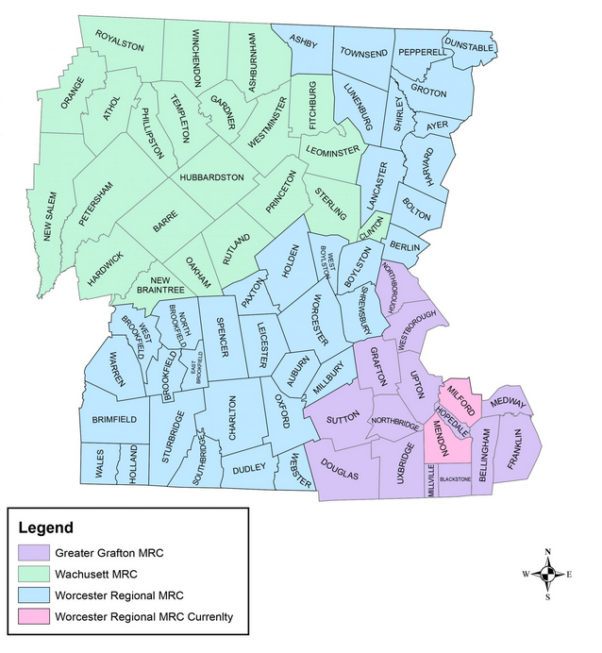
Local MRC Units- Worcester County
Wachusett MRC
Worcester Regional MRC
Greater Grafton MRC

Slide 12
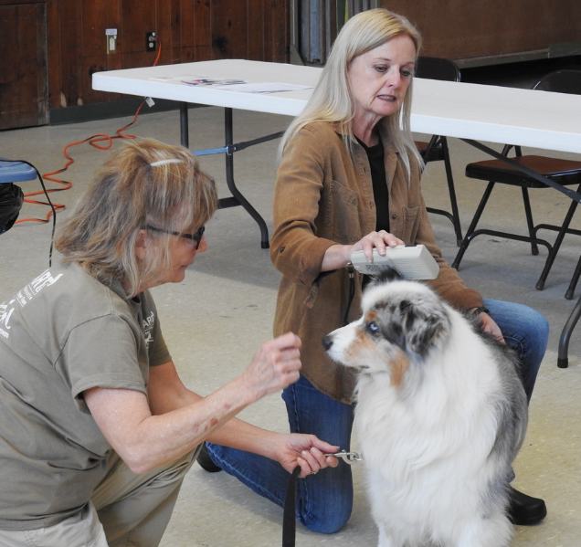
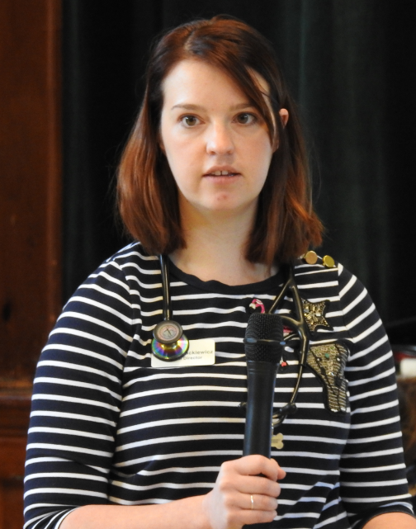
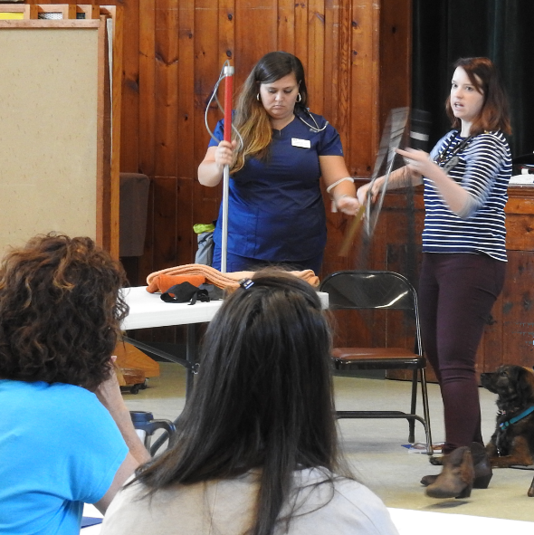
Pet First Aid Training
Deb Jennifer
Providing helpful tips for working with anxious animals

Slide 13
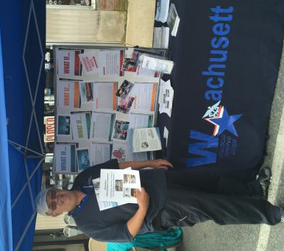
What if…..
Preparedness- Thinking Through Scenarios

Slide 14
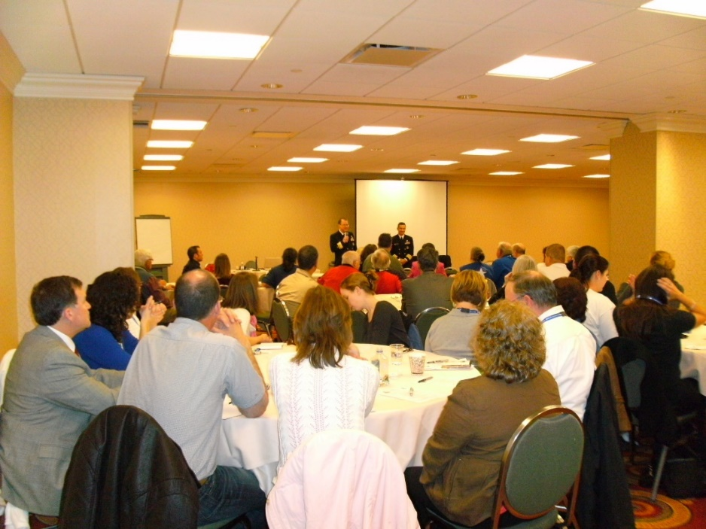
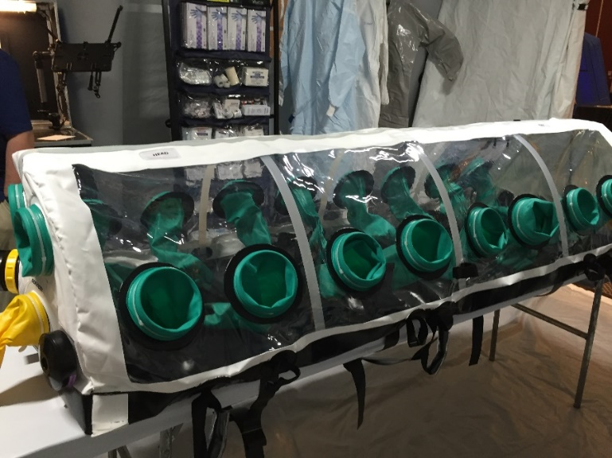
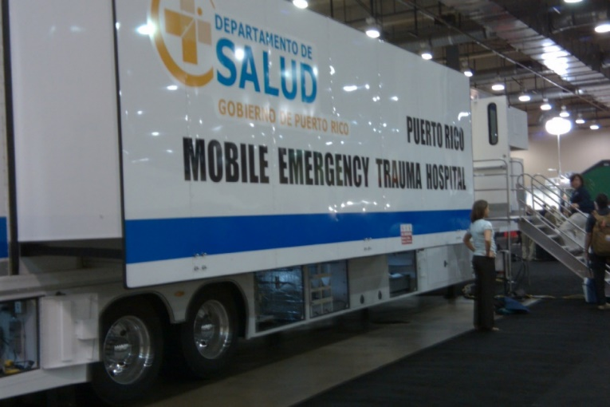
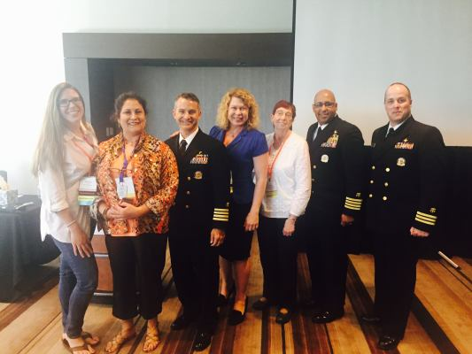
Preparedness Summit

Slide 15
MRC Models
No “typical” MRC
All MRC units:
Provide an organizational structure for utilizing members
Screen members, including CORI/SORI and verification of professional licensure/certification
Train/prepare members
Units vary by:
Types/#s of volunteers
Sponsor organizations
Partner organizations
Mission/focus

Slide 16
MRC Unit Organization
Each MRC unit determines its organizational structure that best fits their needs. Some determinants are
Population
Geography
Community government structure
Health needs
Other unique community factors
Differing laws and local government structure
one “size” does not fit all

Slide 17
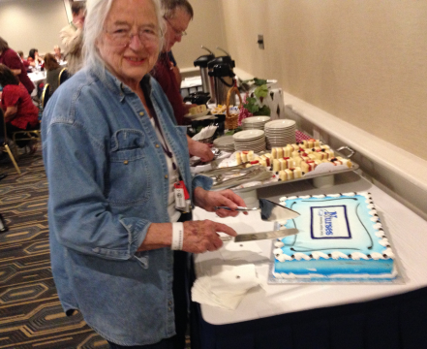
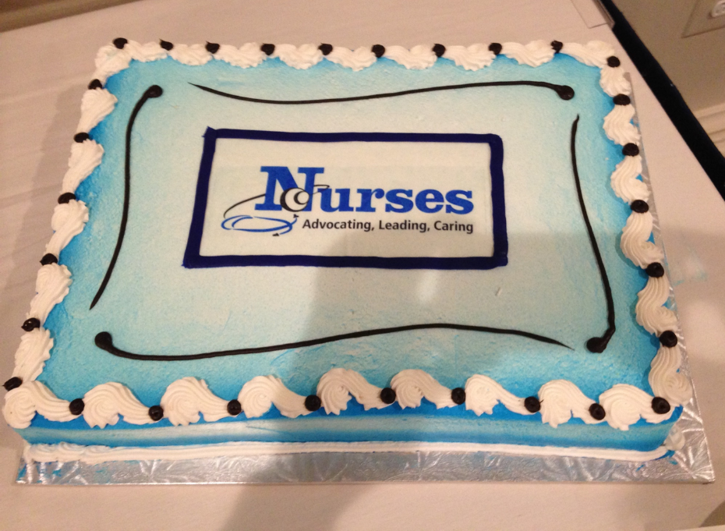
Celebrating Nurse’s Week
Rita is our oldest volunteer and has been with us since day 1. She brings wisdom from her
60+ years in Public Health

Slide 18
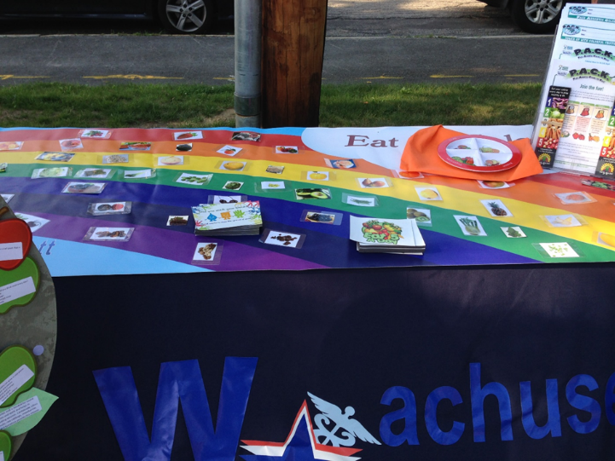
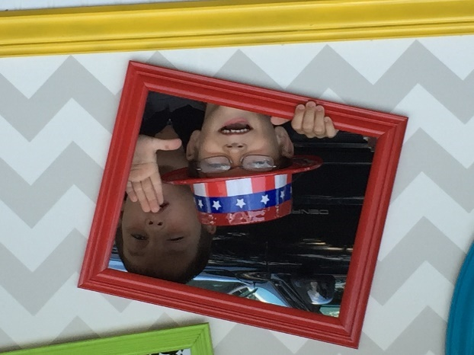
Children’s Night Out- EAT BY COLORS

Slide 19
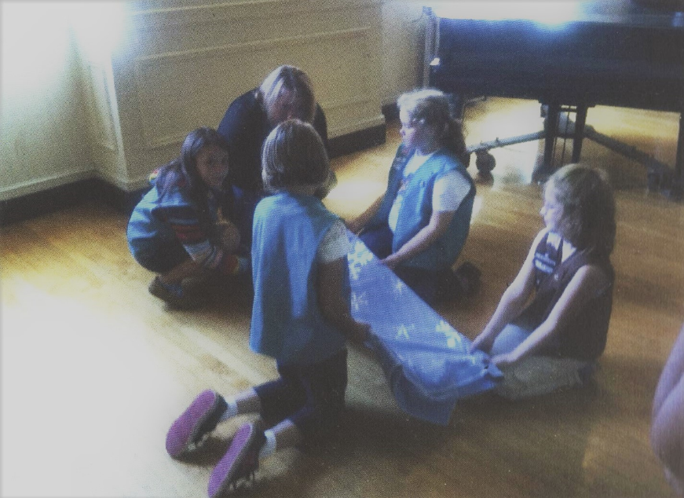
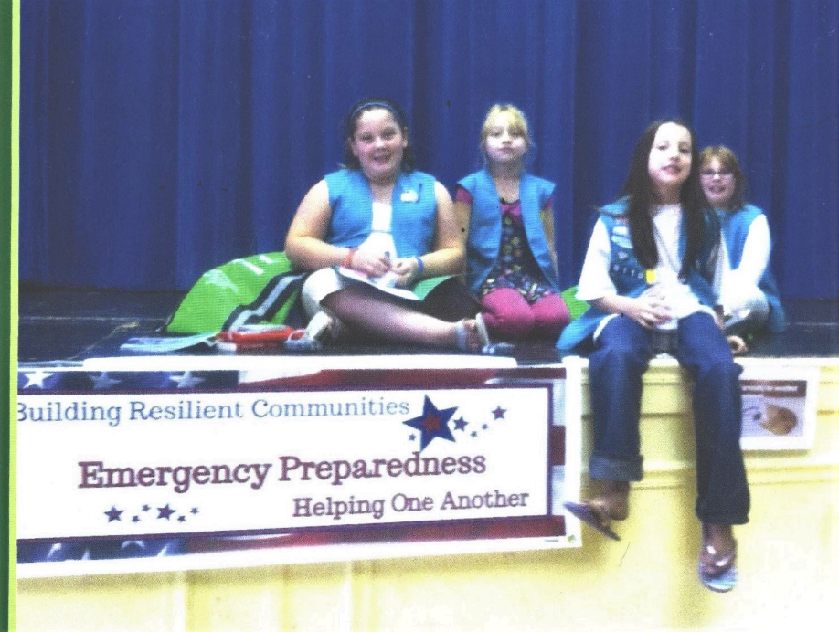
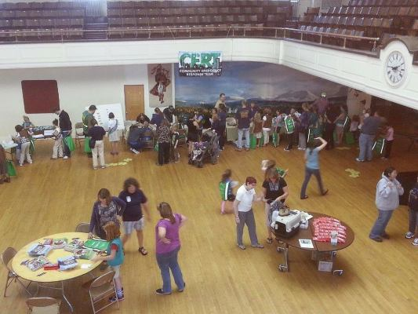
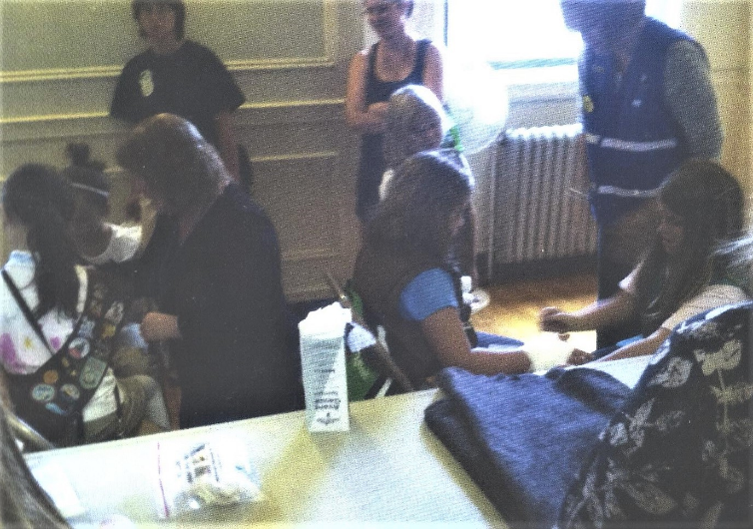
Special Events- Girl Scout Program

Slide 20
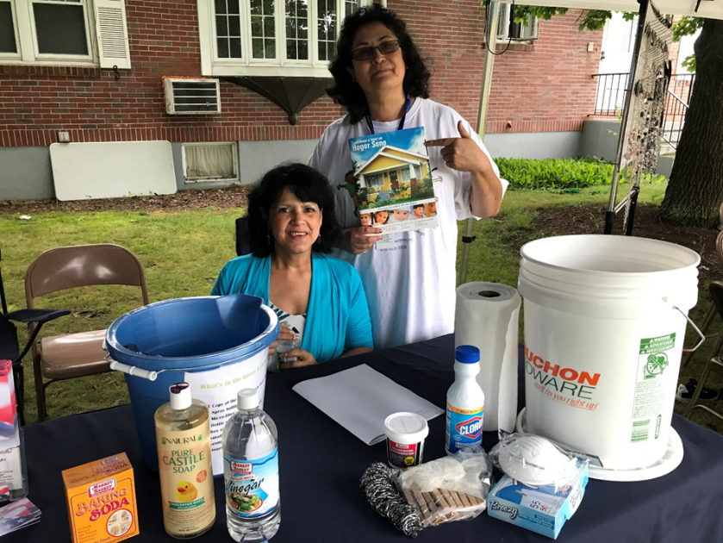
Healthy Homes
Grant supported program teaching about using natural cleaning products to offset asthma triggers in the home.

Slide 21
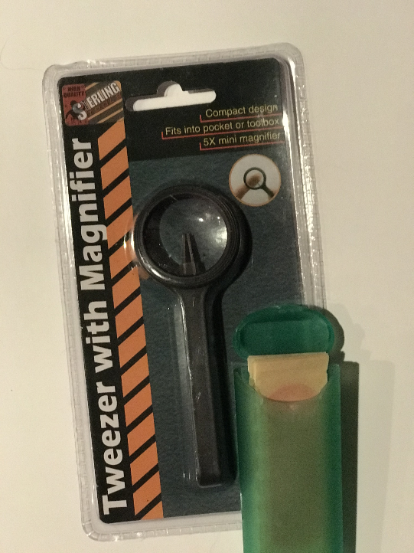
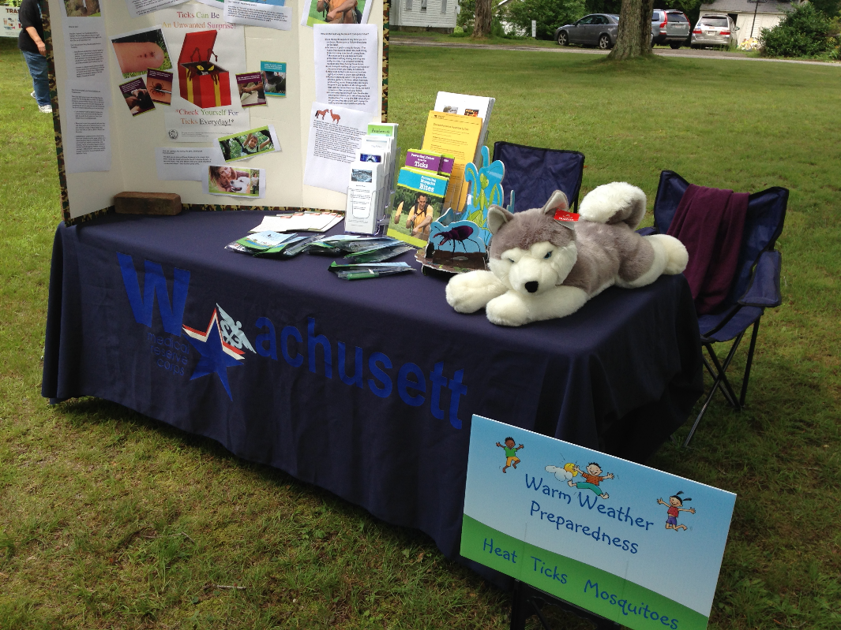
Tickborne Diseases
Done in response to several requests from local Boards of Health - A Tickborne Disease information display coupled with the distribution of 1400 tick removal kits.

Slide 22
Volunteers
Types/# of Volunteers - local decision based on local needs
May include those in training, in active practice, or retired
Medical and public health professionals
Persons with no health experience who can help with communications, administration, logistics, and other essential functions
Notes:
Individuals interested in volunteering should contact the nearest MRC to find out more about the local unit and to obtain a volunteer application. If there is not a local unit in their area, individuals are encouraged to contact local health and response agencies to encourage them to start one in the community.
To find a local MRC in your area visit the MRC website at http://www.medicalreservecorps.gov/FindMRC.asp

Slide 23
Response Roles
MRC members can have a profound impact on the health and safety of their community during an event requiring MRC assistance.
Examples:
Serve as MRC team leaders
Provide medical care, administer vaccines and dispense medications
Provide health education as part of a local public health initiative
Provide counseling for victims, families and responders
Promote preparedness
Provide administrative, logistical and communications support
Notes:
These are only a few examples of the roles that MRC volunteers can play in their community.
Local units support and assist their community’s existing resources – so roles/activities of MRC units depend on the needs of the local community
Those interested are encouraged to contact units in their area or state for more information on what activities local units are participating in

Slide 24
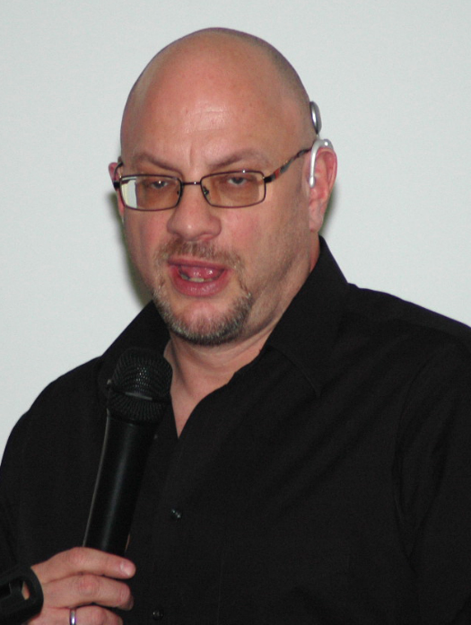
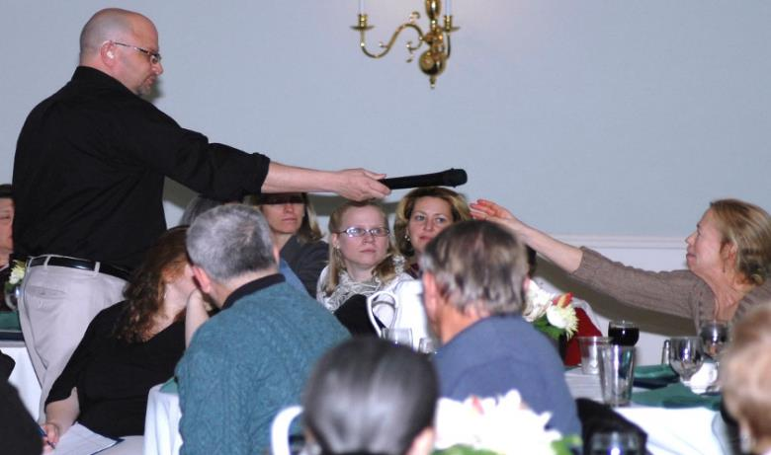
Learning About The Deaf Community
Special Guest Jonathan O’Dell
MA office for the Deaf

Slide 25
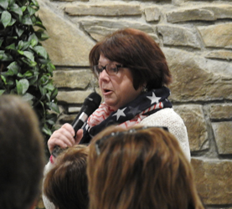
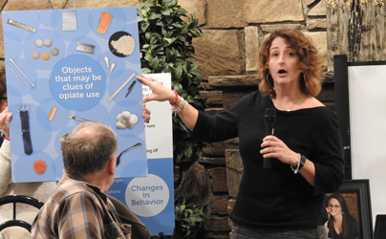
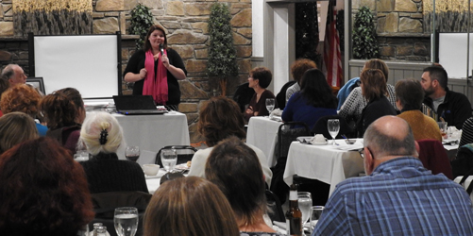
Addiction from a Parent’s View
Heather
Michelle and
Susan share

Slide 26
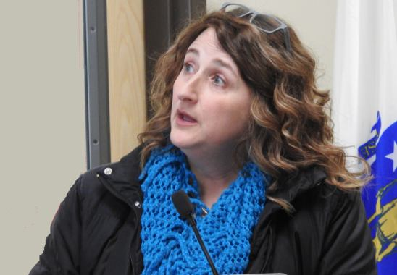
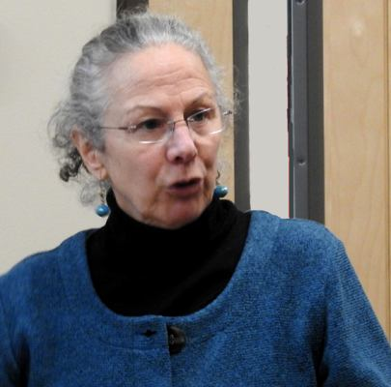
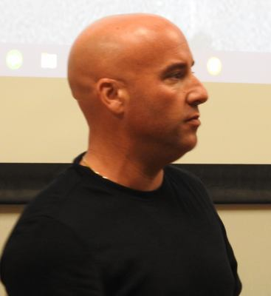
Vaping, Addiction Recovery Discussion and Narcan Training
Michelle
Alyssa’s Place
Tina
UMass
Keith
AIDS Project –Narcan Training

Slide 27
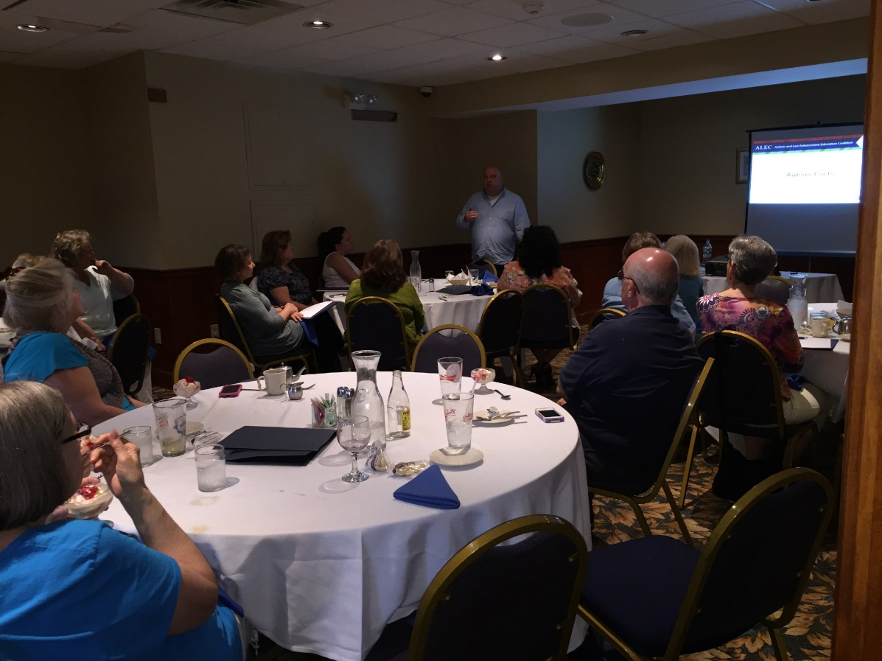
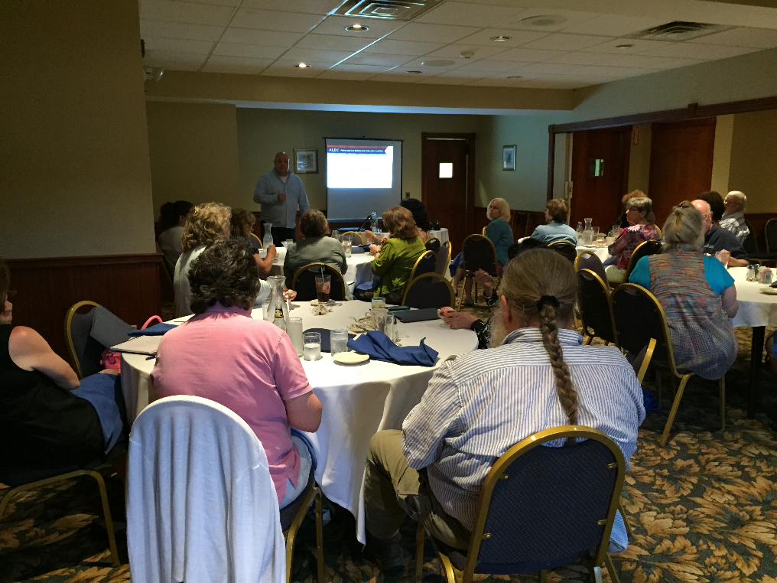
Learning about Autism Real Time-from a Parent

Slide 28
Who We Are
The Wachusett Medical Reserve Corps (WMRC) was federally approved on March 11, 2006 and is based in Hubbardston, Ma.
The Wachusett MRC is a 501(c)3 non profit organization with a team approach of government.
It is a ‘member run’ unit that values each member's contribution as valid. We keep lines of communication open through emails, frequent website updates, and training meetings.

Slide 29
What We Can Do
The role of the healthcare community in disaster preparation is
to identify resources applicable to physical, social and psychological effects of a disaster,
to identify population groups that are at the greatest risk during a disaster,
to provide disaster education in advance of the event, and
to take responsibility for the health of the community following a disaster.

Slide 30
Public Health
MRC volunteers serve a vital role by assisting their communities with ongoing public health needs. This can be accomplished through
community health profiles that identify needs,
developing educational programs,
providing screening clinics and
working with the local health officials as a resource for public health initiatives.

Slide 31
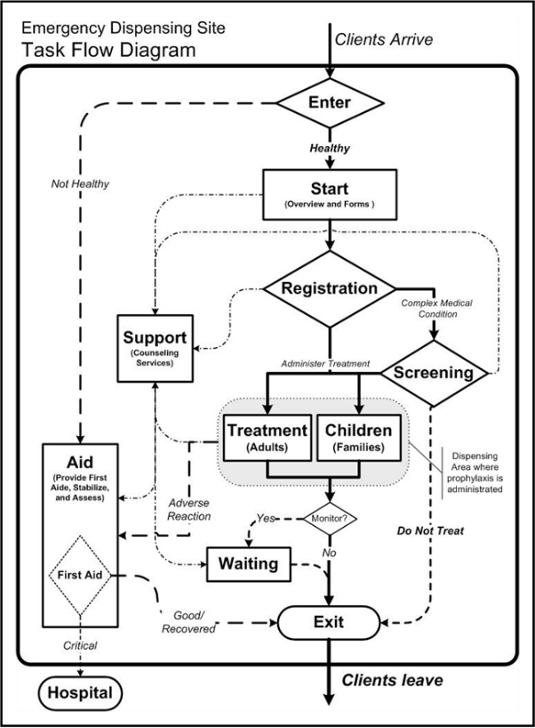
Participating in Public Health Drills
Kathy and Barry

Slide 32
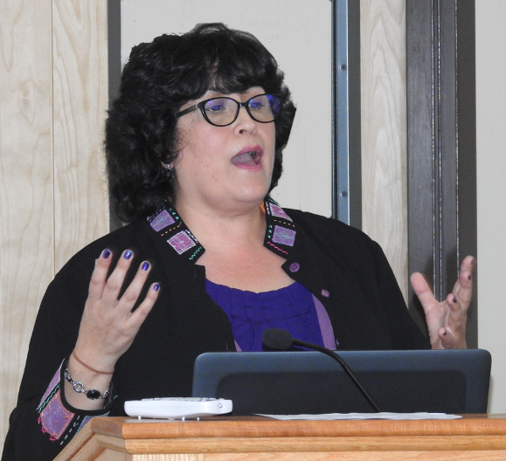
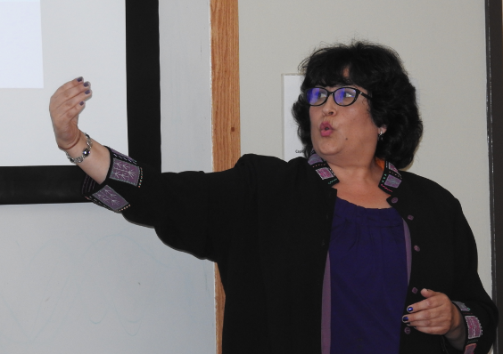
Psychological First Aid Training
PJ - VP of the Wachusett MRC – Mental Health Counselor- Certified Interpreter- Jack of all trades

Slide 33
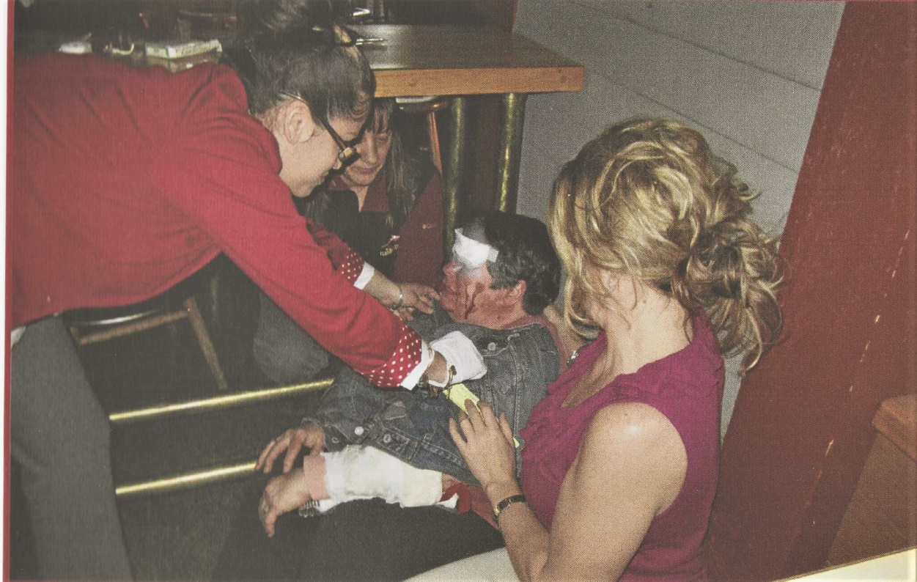
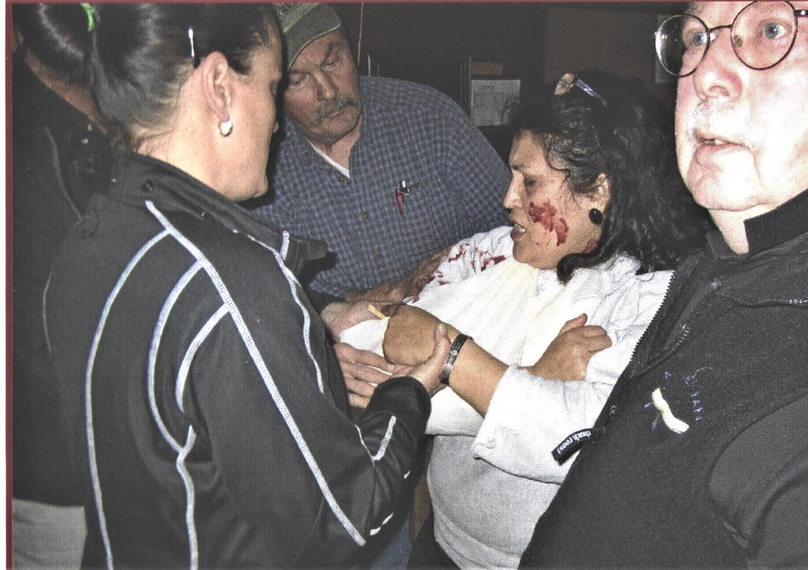
Triage Training

Slide 34
How Can an MRC Benefit Your Community?
Resiliency – not as reliant on state and national resources
Meet identified health needs/gaps
Bolster public health and emergency response infrastructures
Give community members an opportunity to help make their communities healthier and safer
Provide mechanisms for information sharing and coordination between partner organizations
Allow for national recognition of local public health and emergency response efforts
Notes:
These are only some of the ways that MRC can benefit your community.
We encourage you to sign up for the MRC Message Board (http://www.medicalreservecorps.gov/UserRegistration.asp) and List-Serve (https://list.nih.gov/cgi-bin/wa?SUBED1=medicalreservecorps-l&A=1) to receive and share information regarding how MRC units are making an impact in their communities.

Slide 35
What role might I play?
The role you play in a response depends upon your training and skills. Possible emergency response roles are:
Assisting in delivery of medical care within your level of expertise as an RN, LPN, CNA, MD, EMT, medical secretary, or other credentialed volunteer.
Providing mental health/spiritual support.
Providing medical interpreting and translation services.
Assisting with set up and flow of clinics.
Lending the community your special skills during an emergency event.

Slide 36
Stop the Bleed Training
Community presentations available for You are the Help and Stop the Bleed.

Slide 37
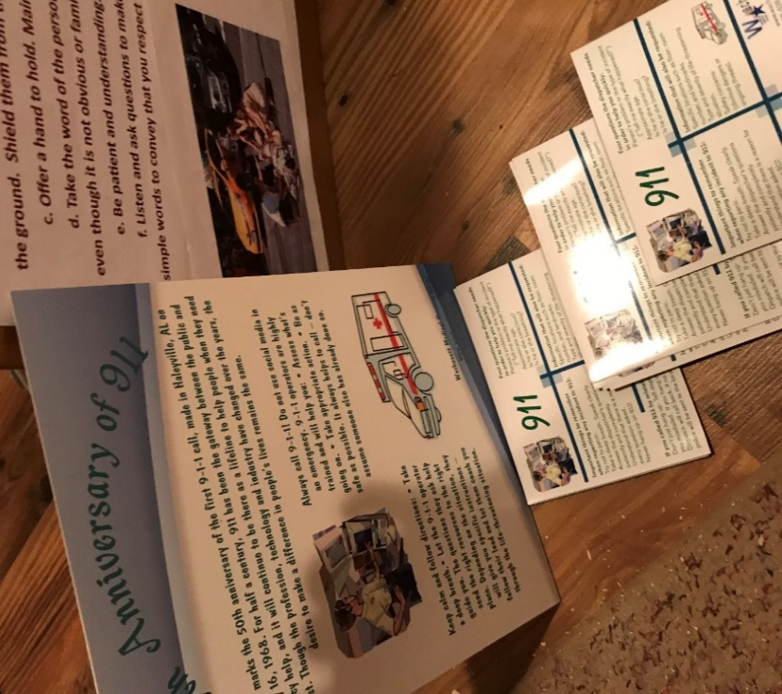
Anniversary of 911
50 years
What to say in an emergency.

Slide 38
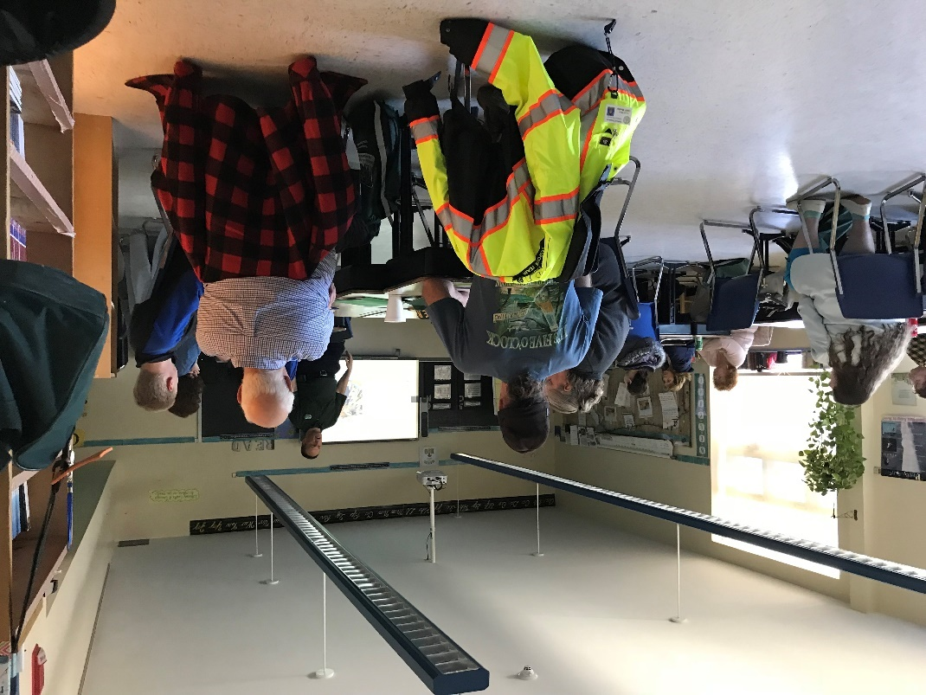
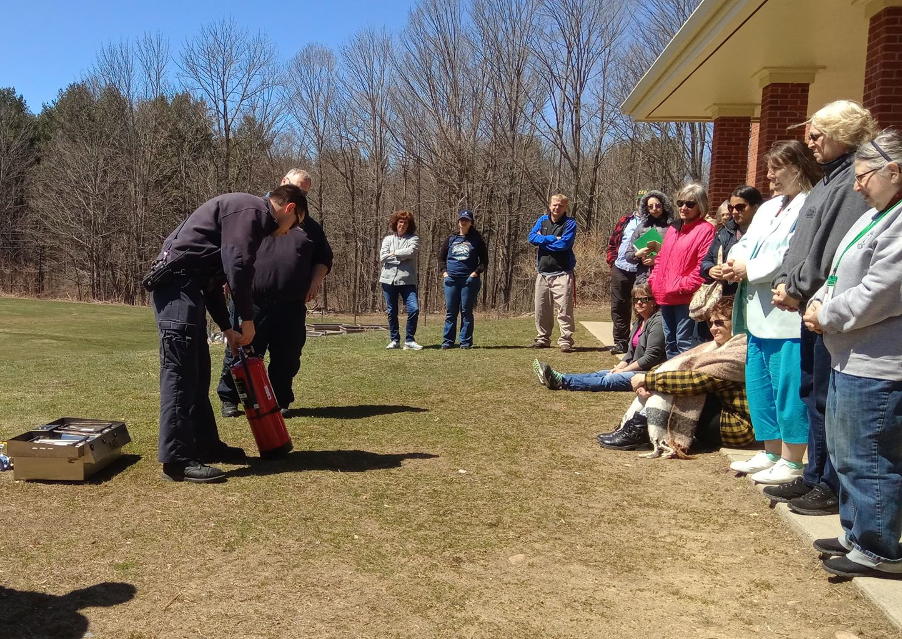
CERT/MRC Training
Community Emergency Response Teams train and work together with Medical Reserve Corps Units in a disaster

Slide 39
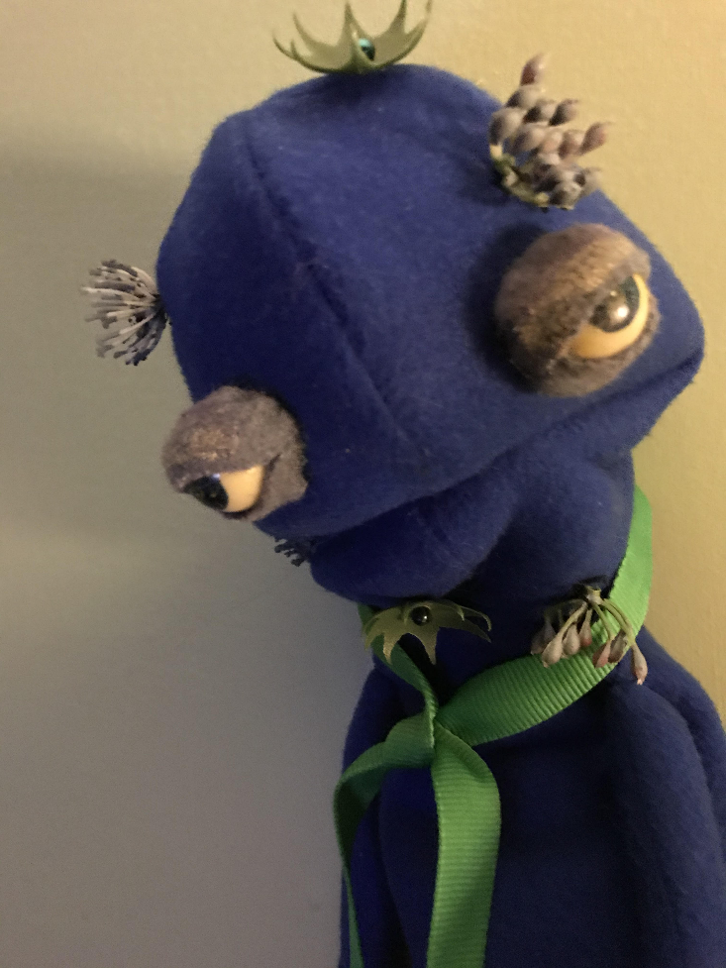
WHACK the Flu
“Victor the Virus”
A puppet talks about the 5 rules of good health.

Slide 40
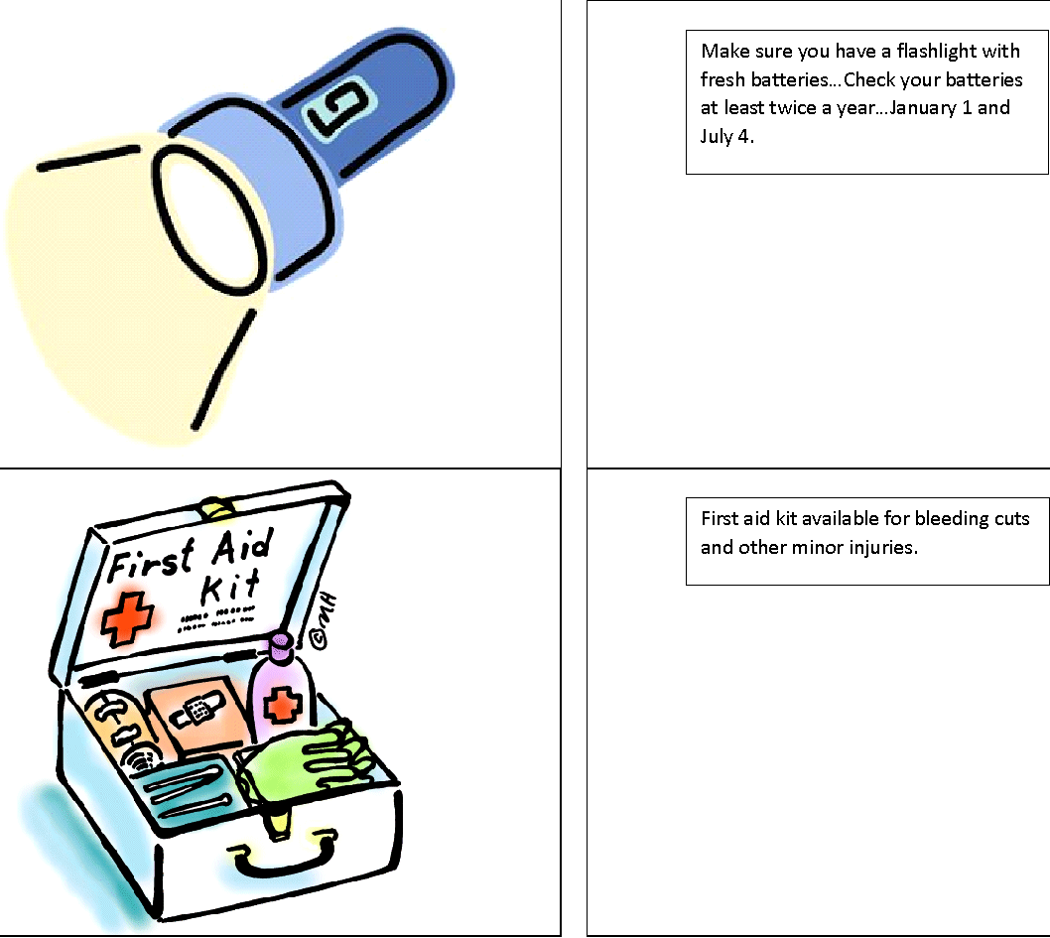
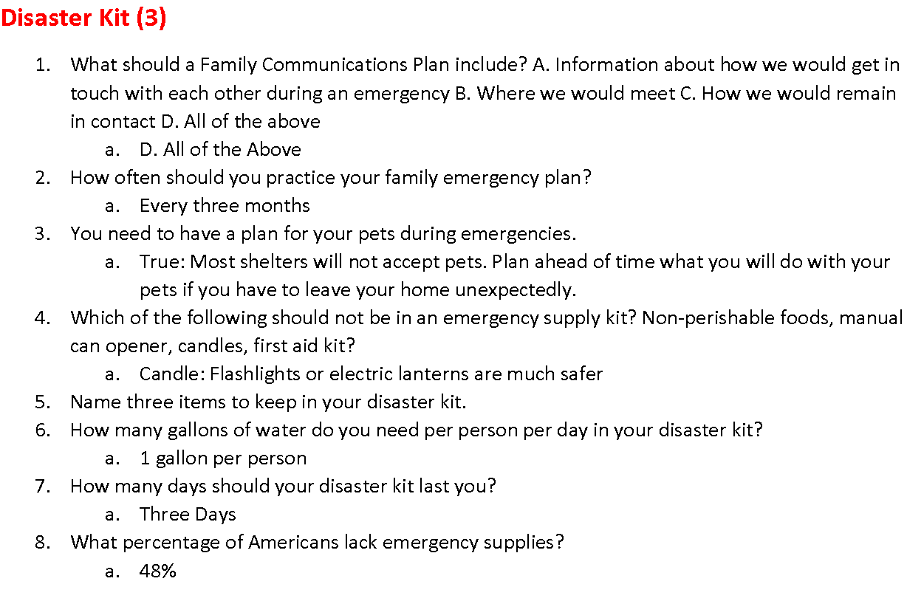
Learning Games
Children’s Matching Game
Trivia Games
Preparedness Bingo

Slide 41
COVID19 PSA DoorHangers
Vongmany
20,000 door hangers distributed throughout Worcester County

Slide 42
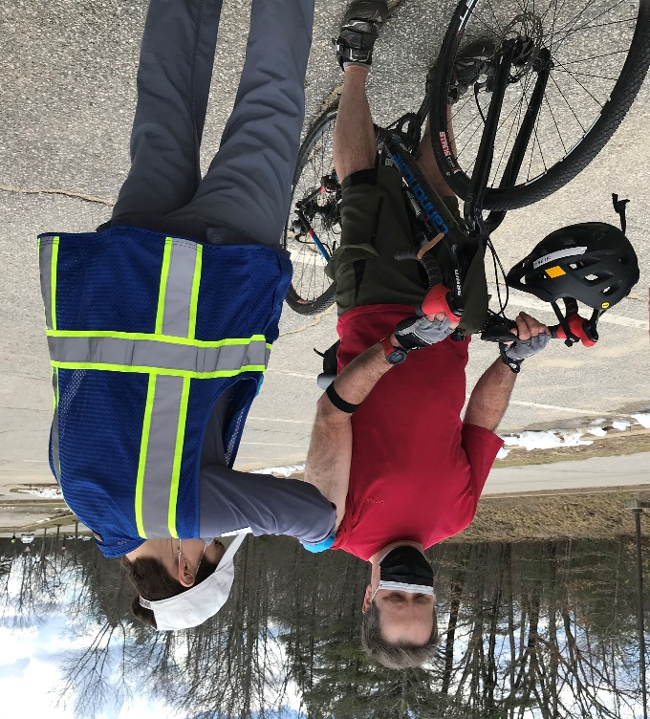
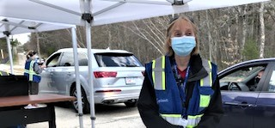
Clinics and more Clinics… 15 months, 300 volunteers and 100,000 vaccines
Wind
Rain
Snow
Sleet
Freezing Temperatures

Slide 43
Never doubt that a small group of thoughtful, committed citizens can change the world. Indeed, it’s the only thing that ever has. — Margaret Mead

Slide 44
How to Contact Us
Would you like to become a member of the Wachusett Medical Reserve Corps?
Please get in touch!
Our telephone number is 978-928-3834.
Our email is: wachusettmrc@gmail.com
Our website is: www.wachusettmrc.org
Our mailing address is: Wachusett MRC PO Box 555
Hubbardston, MA 01452

